Slide 1
Functions
G.H. Raisoni College of Engineering and Management ,Wagholi, Pune
By- Pratik Rajesh Jade
Roll no- A72
Faculty name: Ms Mughda Kirkire

Slide 2
Functions
Functions "Encapsulate" a task (they combine many instructions into a single line of code). Most programming languages provide many built in functions that would otherwise require many steps to accomplish, for example computing the square root of a number. In general, we don't care how a function does what it does, only that it "does it"!
A function is a block of code that performs a specific task.Suppose, you need to create a program to create a circle and color it. You can create two functions to solve this problem:
create a circle function
create a color function
Dividing a complex problem into smaller chunks makes our program easy to understand and reuse.

Slide 3
Use of Functions
C functions are used to avoid rewriting same logic/code again and again in a program.
There is no limit in calling C functions to make use of same functionality wherever required.
We can call functions any number of times in a program and from any place in a program.
A large C program can easily be tracked when it is divided into functions.
The core concept of C functions are, re-usability, dividing a big task into small pieces to achieve the functionality and to improve understandability of very large C programs.

Slide 4
Types of function
There are two types of function in C programming:
Standard library functions
User-defined functions

Slide 5
Standard library functions
The standard library functions are built-in functions in C programming.
These functions are defined in header files. For example,
The printf() is a standard library function to send formatted output to the screen (display output on the screen). This function is defined in the stdio.h header file. Hence, to use the printf()function, we need to include the stdio.h header file using #include <stdio.h>.
The sqrt() function calculates the square root of a number. The function is defined in the math.h header file.

Slide 6
User-defined function
You can also create functions as per your need. Such functions created by the user are known as user-defined functions.
How user-defined function works?
#include <stdio.h>
void functionName()
{
... .. ...
... .. ...
}
int main()
{
... .. ...
... .. ...
functionName();
... .. ...
... .. ...
}

Slide 7
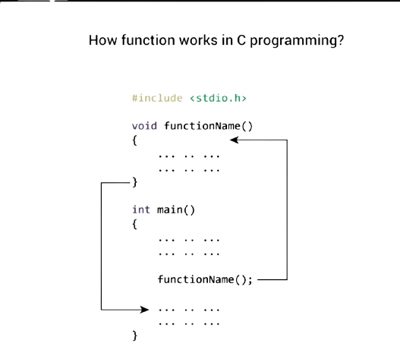
The execution of a C program begins from the main() function.
When the compiler encounters functionName();, control of the program jumps to void functionName()
And, the compiler starts executing the codes inside functionName().
The control of the program jumps back to the main() function once code inside the function definition is executed.

Slide 8
Advantages of user-defined function
The program will be easier to understand, maintain and debug.
Reusable codes that can be used in other programs
A large program can be divided into smaller modules. Hence, a large project can be divided among many programmers.

Slide 9
Thank you...
Reference -https://www.programiz.com/c-programming/c-functions

